Slide 1
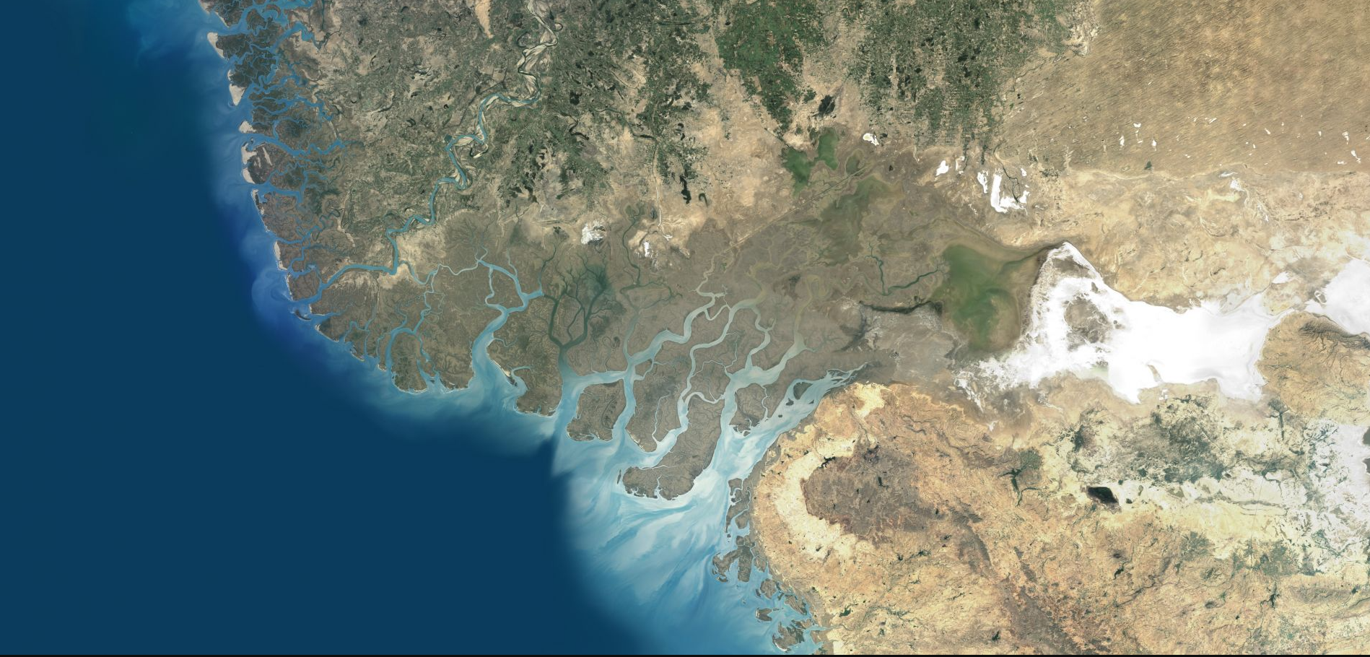

SEA WATER INTRUSION

Slide 2
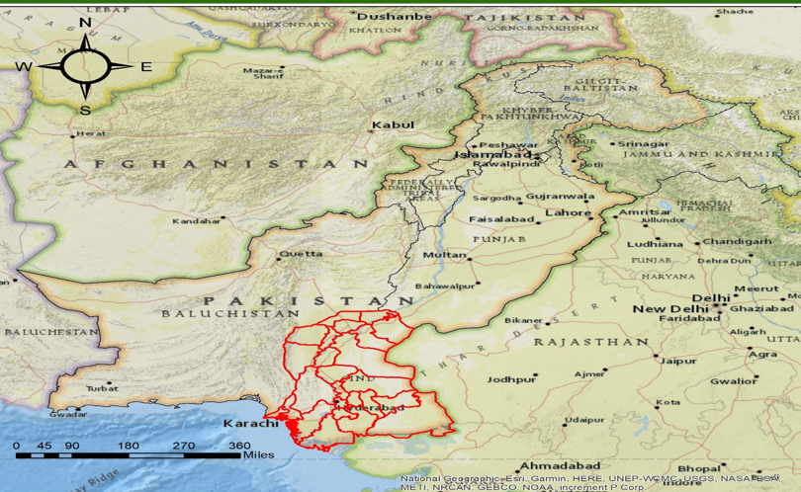
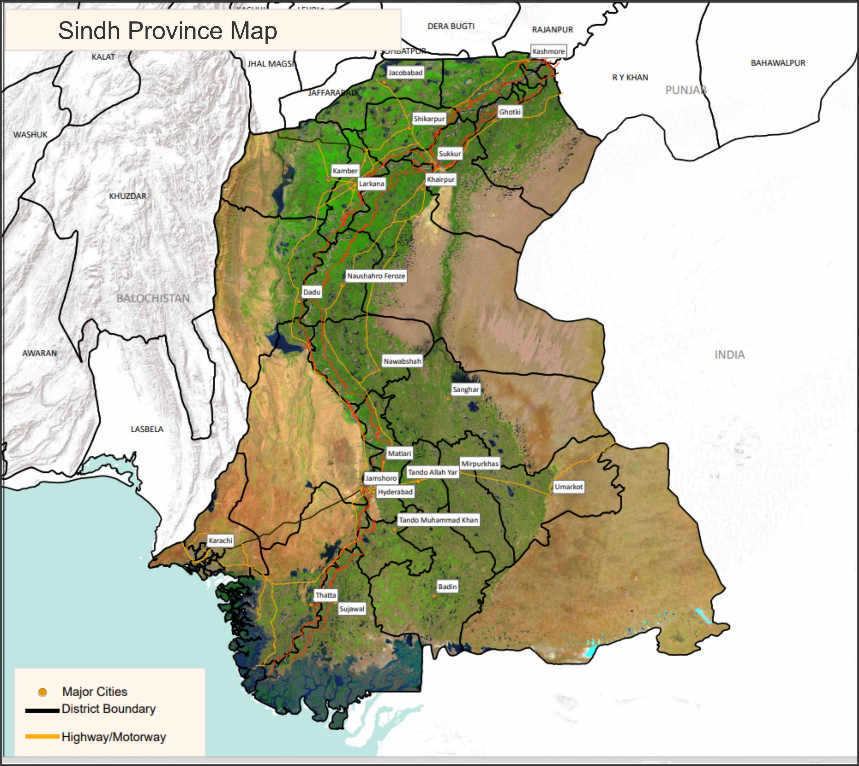
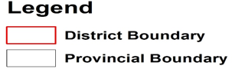
SINDH PROVINCE OF PAKISTAN

Slide 3
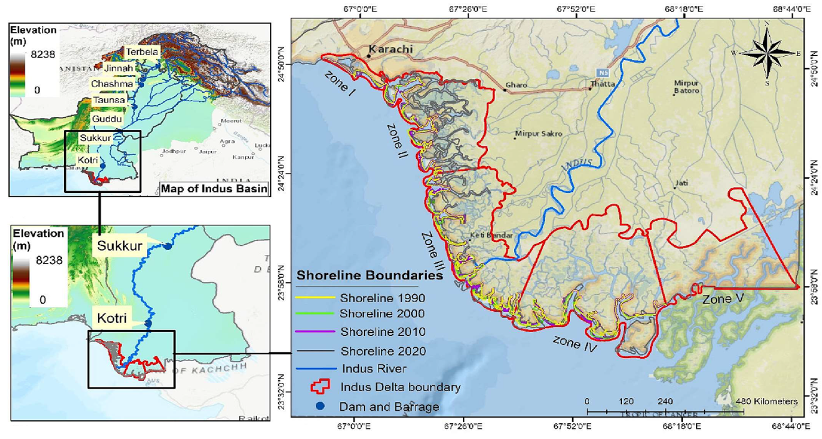
INDUS DELTA (ZONES)

Slide 4
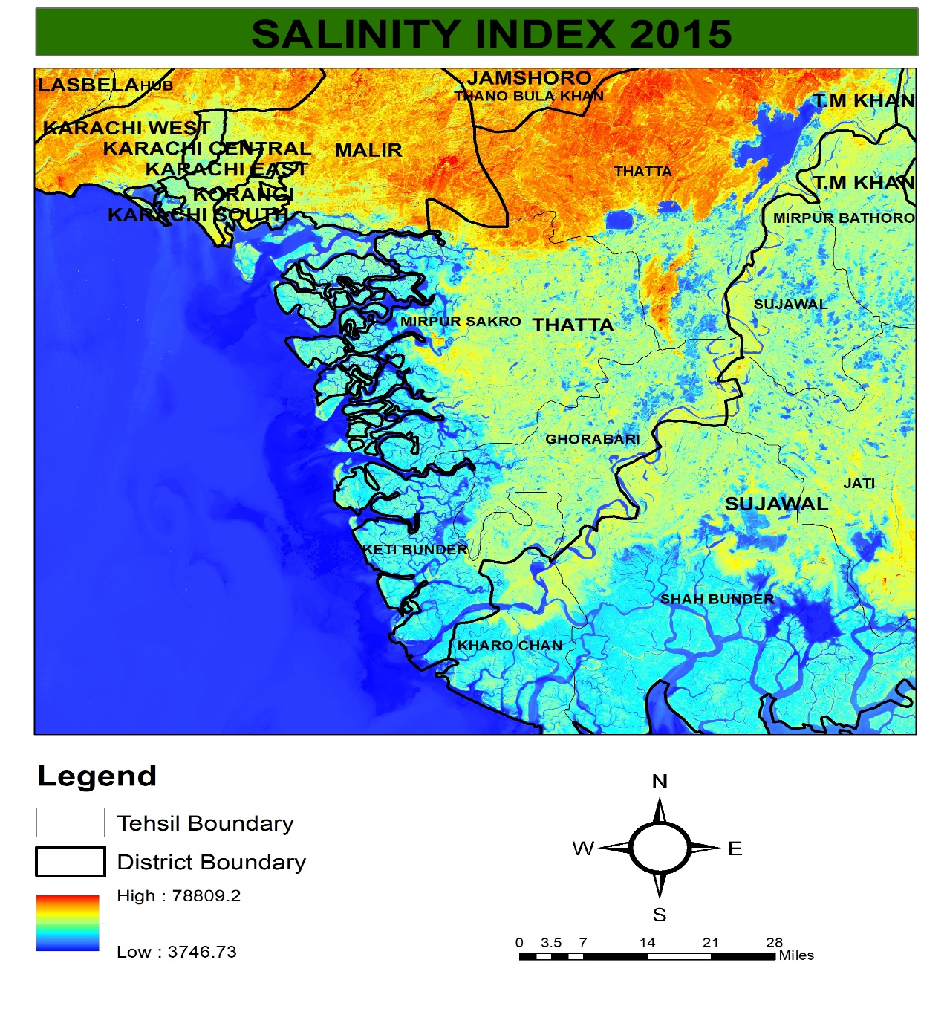
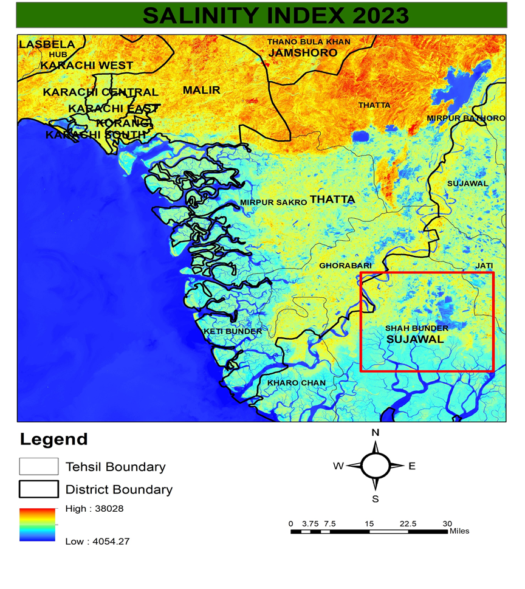
SALINITY INDEX
2015
2023

Slide 5
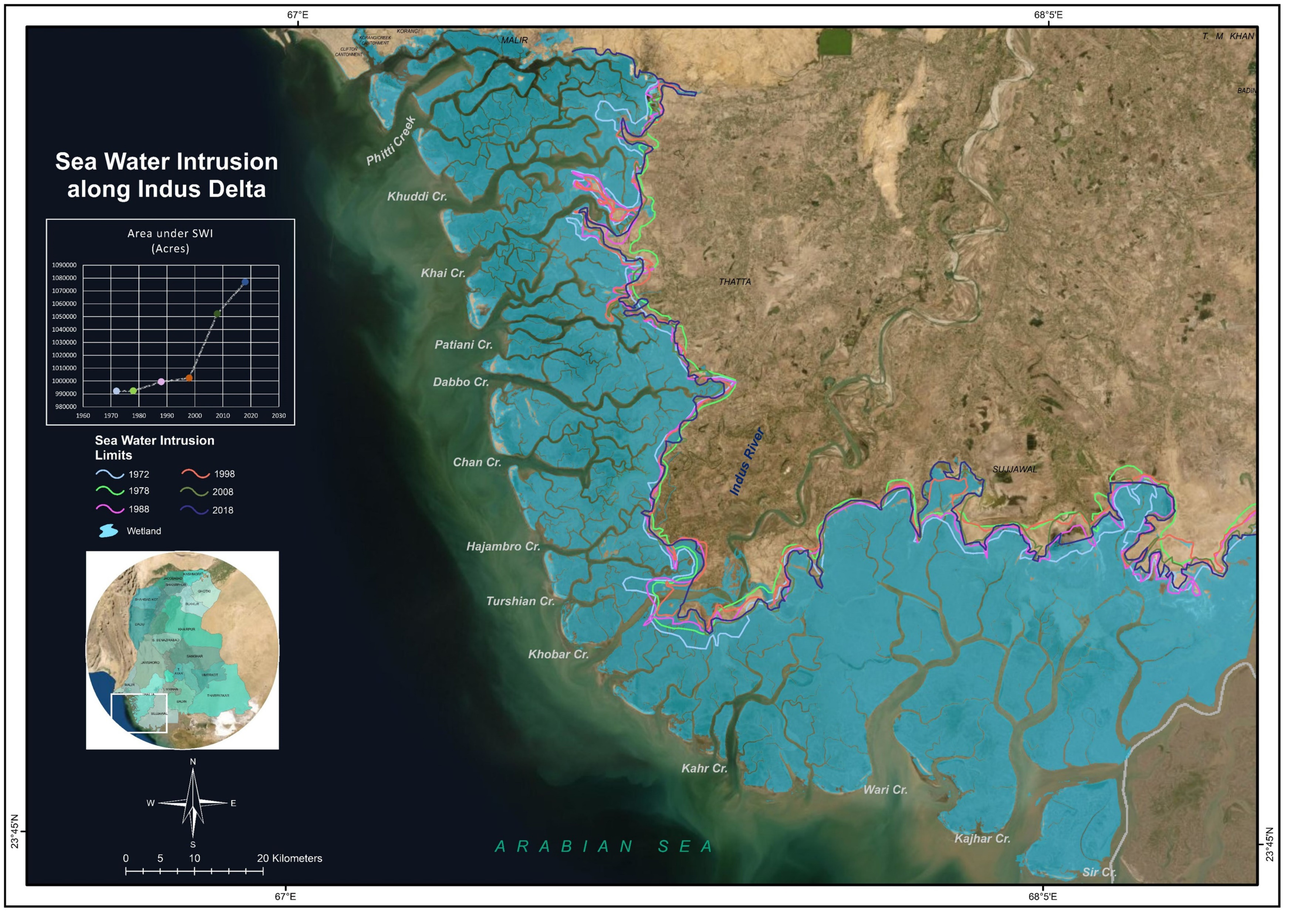
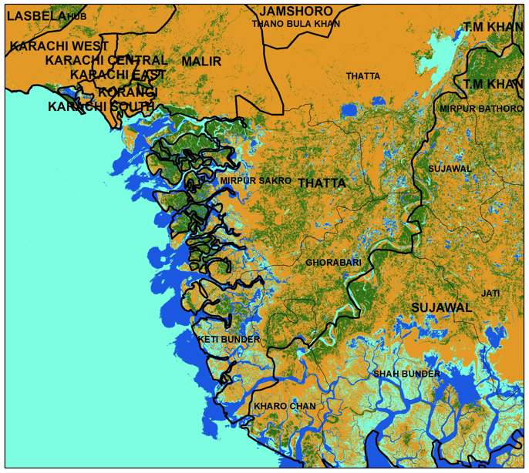
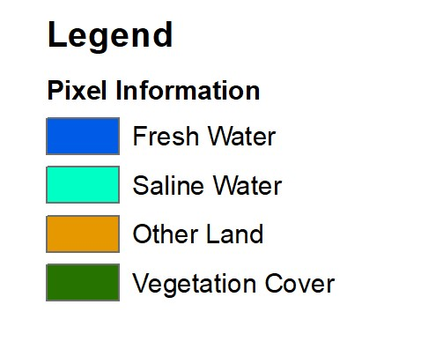
SEA WATER INTRUSION

Slide 6
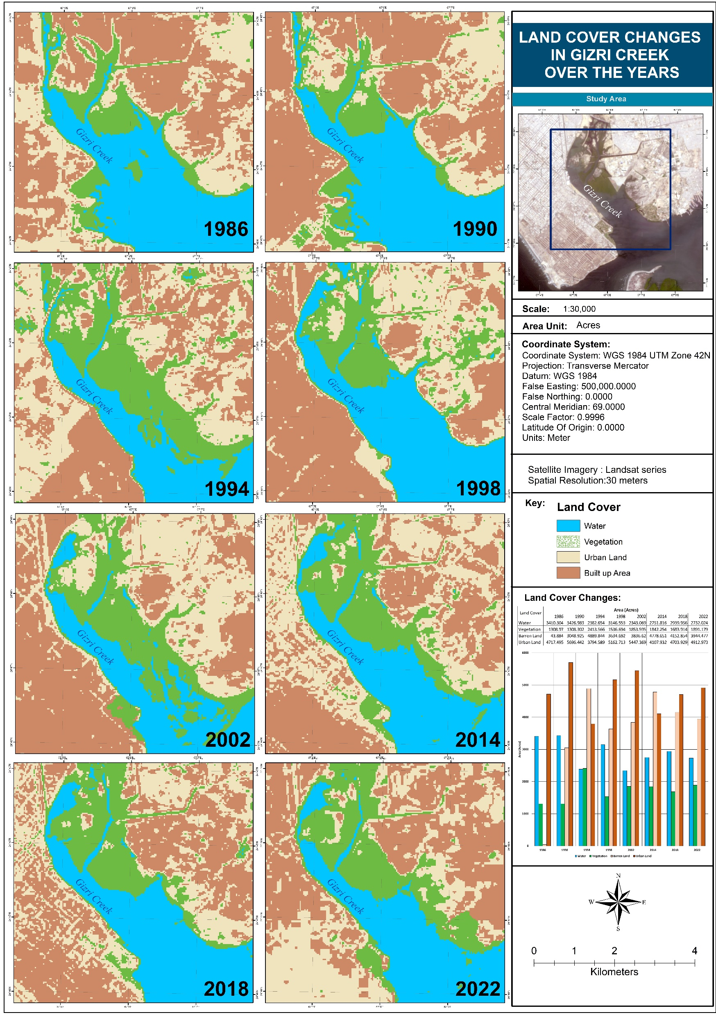
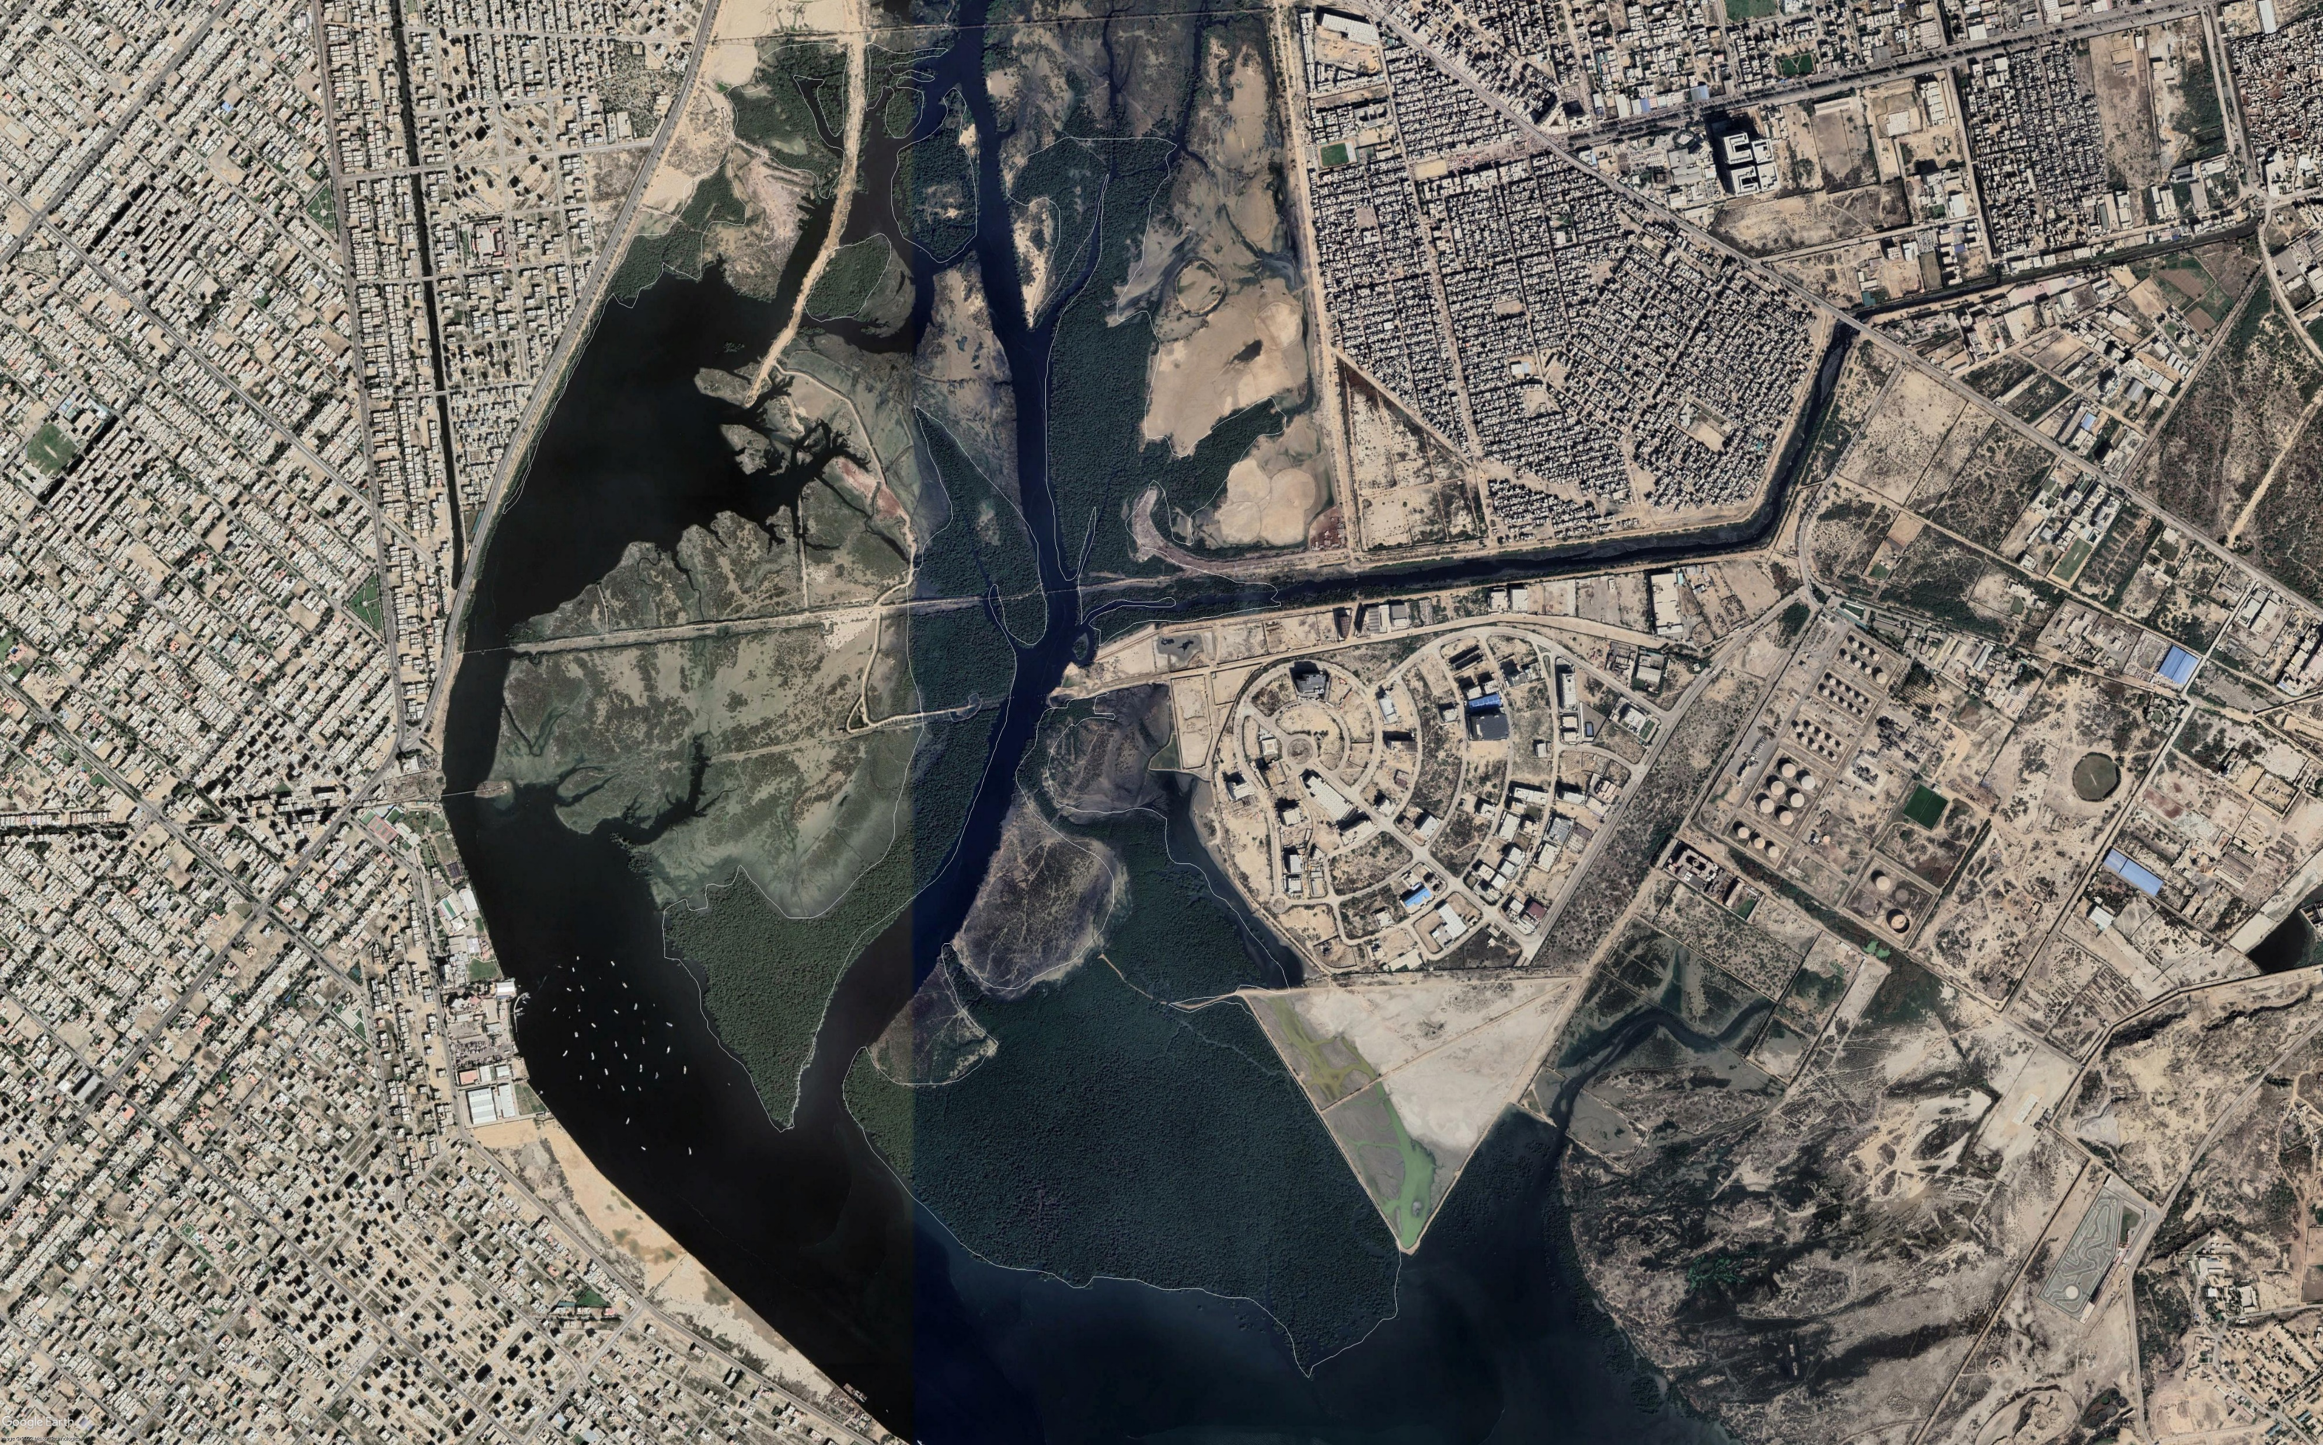
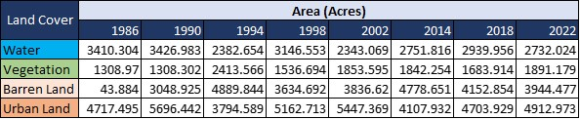
LULC CHANGES

Slide 7
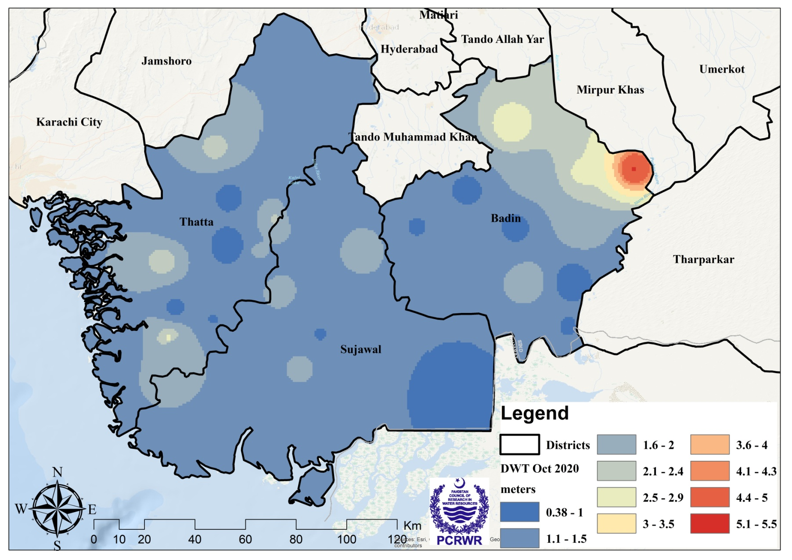
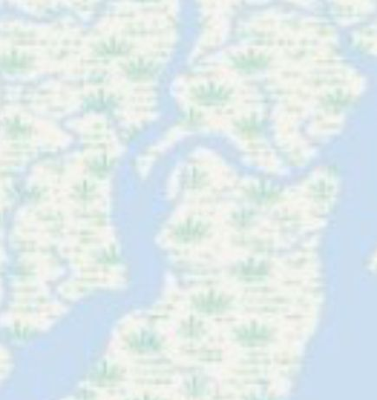
Depth to Water Table (DWT) Measurement
(Sept-October 2019)

Slide 8
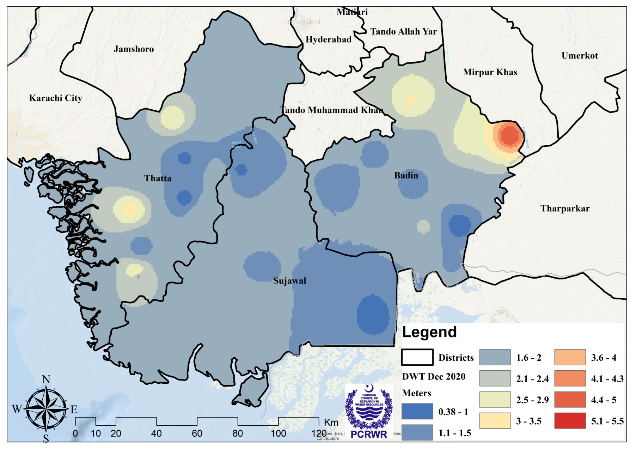
Depth to Water Table (DWT) Measurement
(November-December 2020)

Slide 9
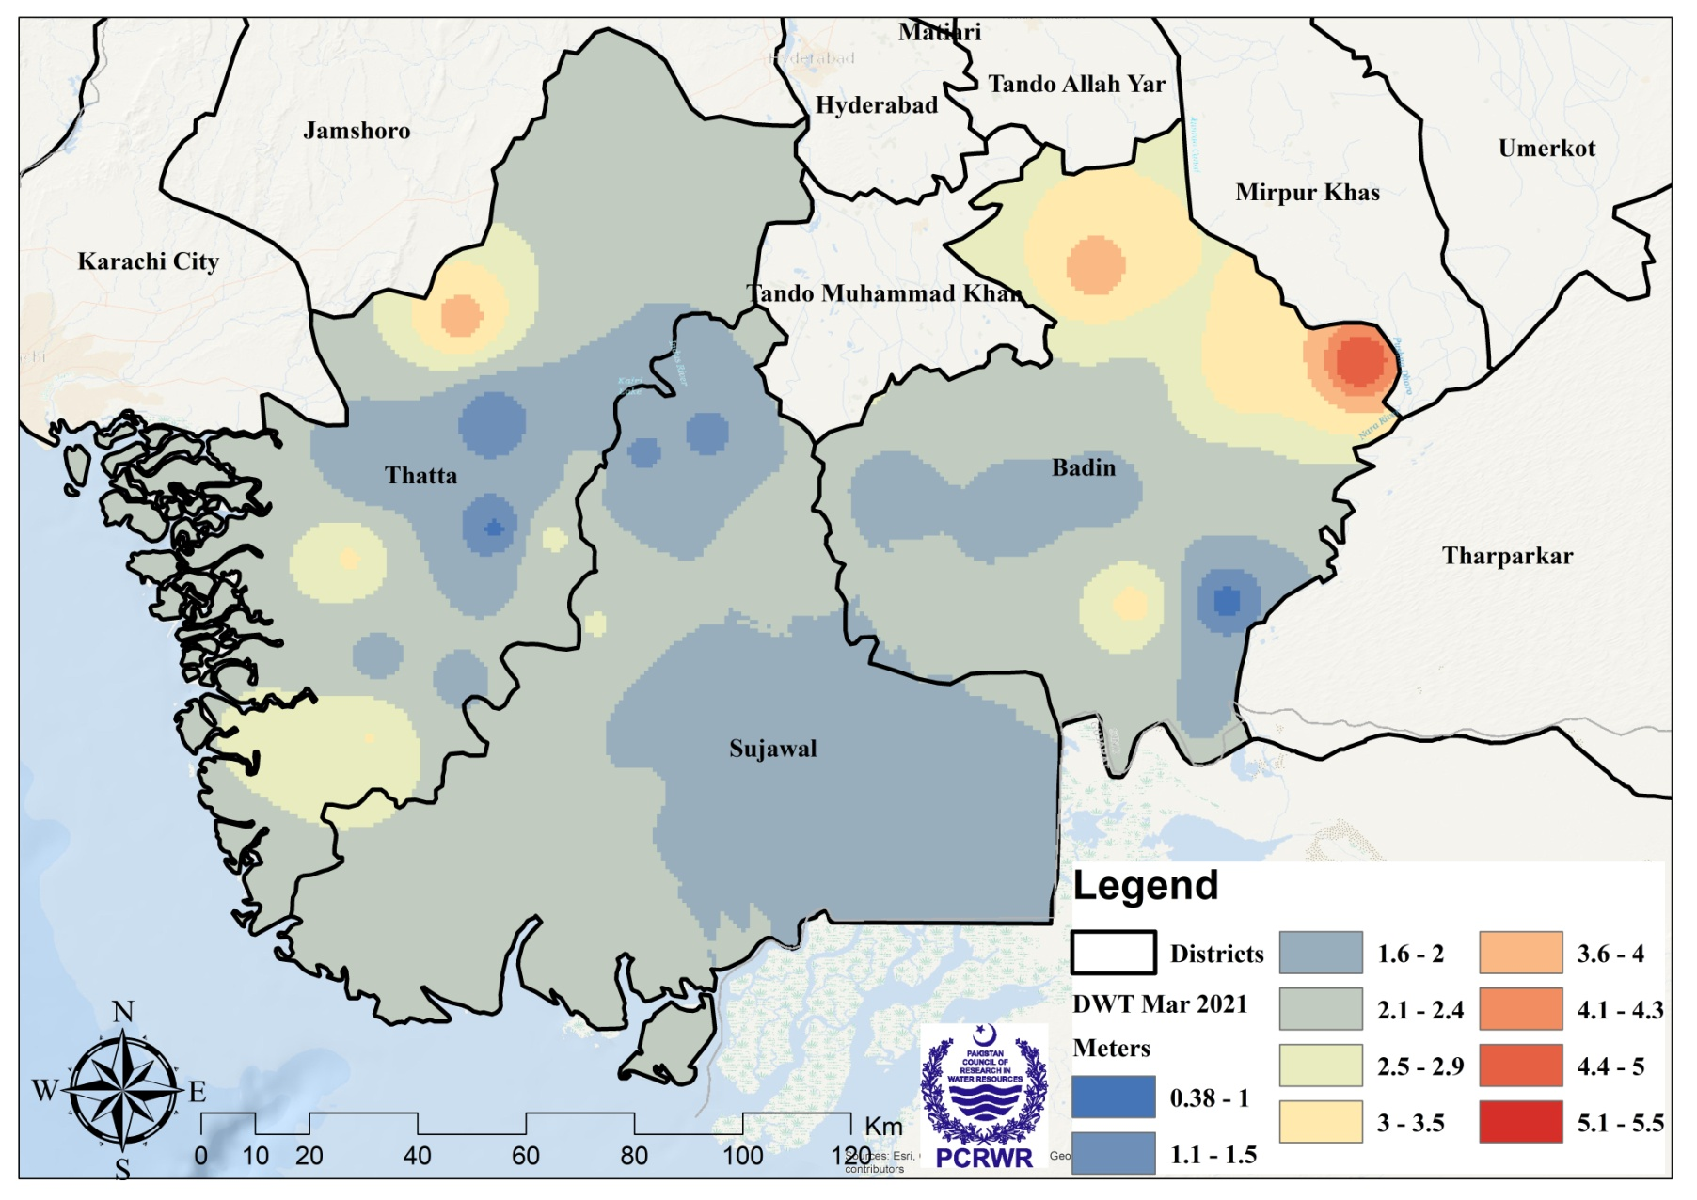
Depth to Water Table (DWT) Measurement
(Feb-March 2021)

Slide 10
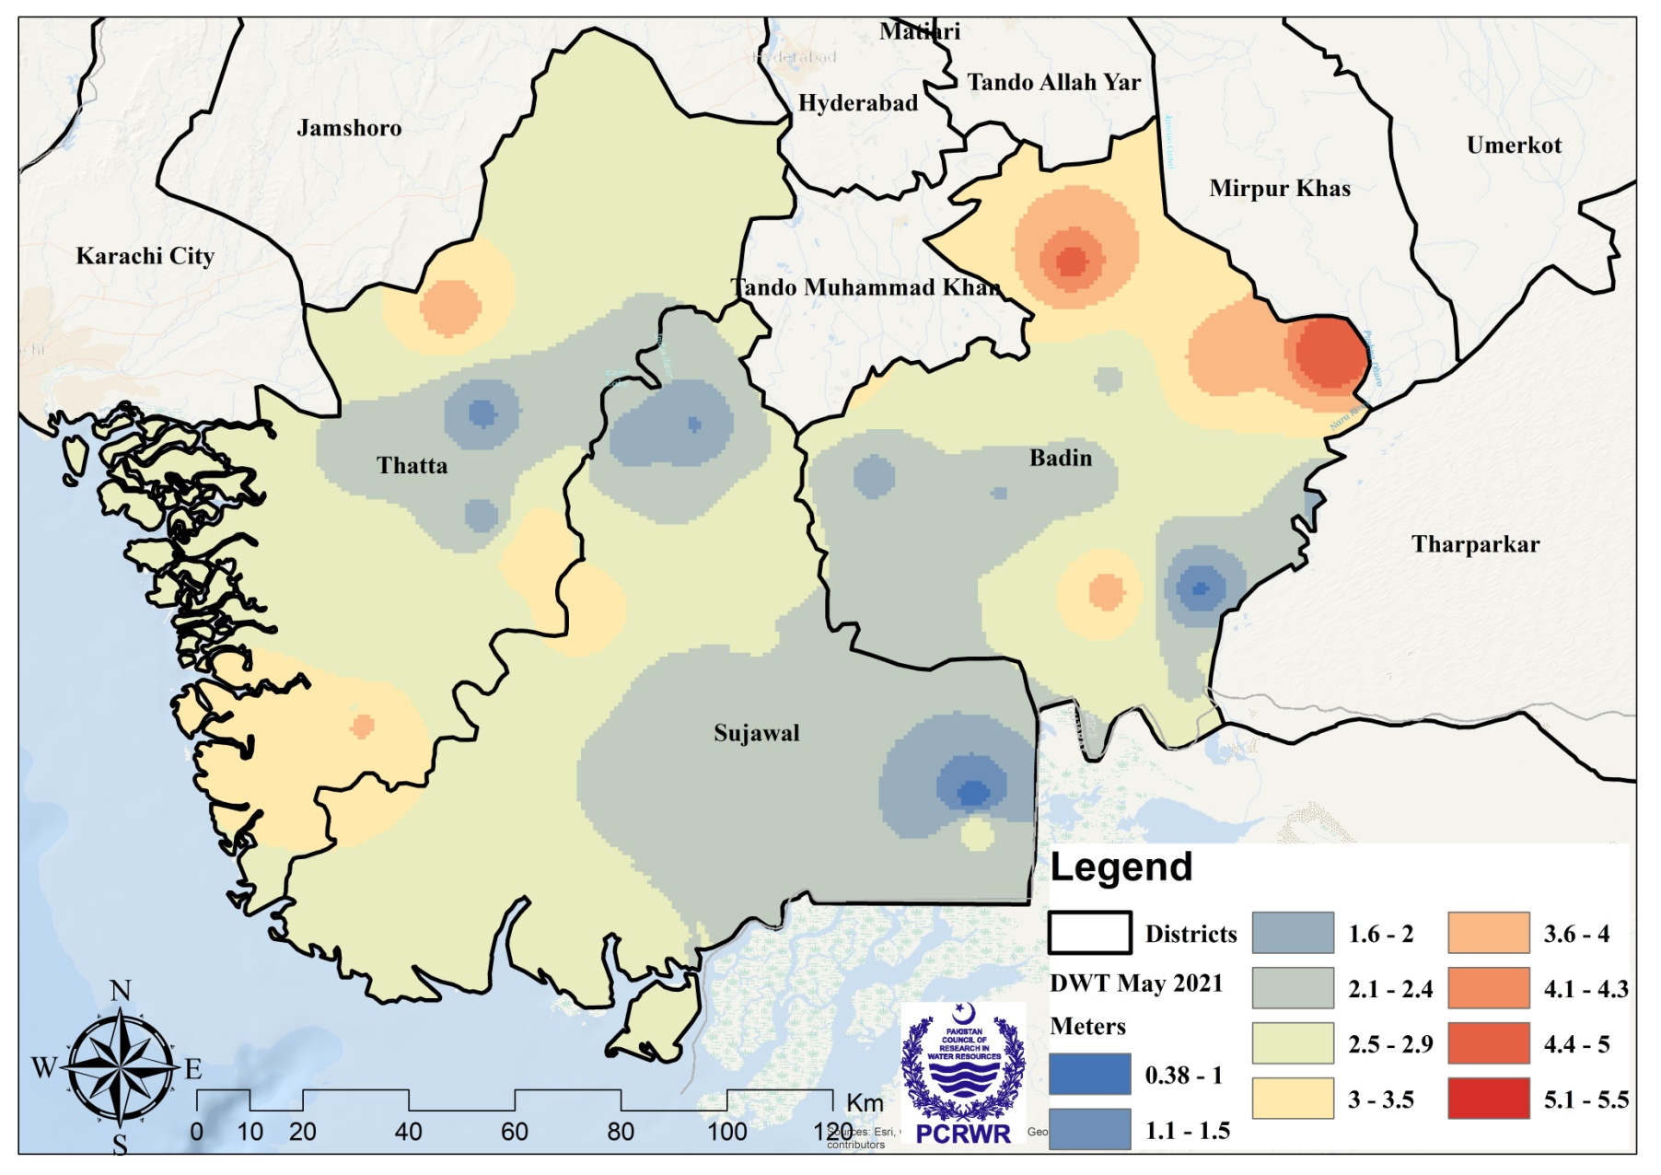
Depth to Water Table (DWT) Measurement
(April-May 2022)

Slide 11
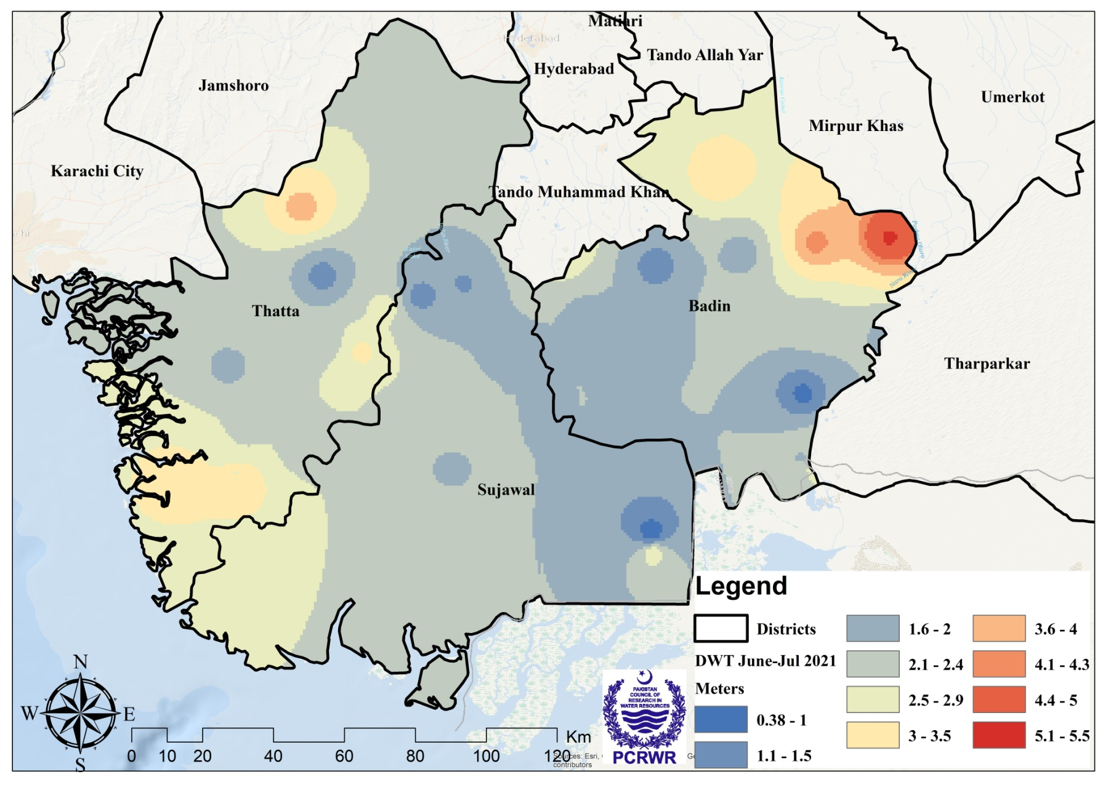
Depth to Water Table (DWT) Measurement
(June-July 2023)

Slide 12
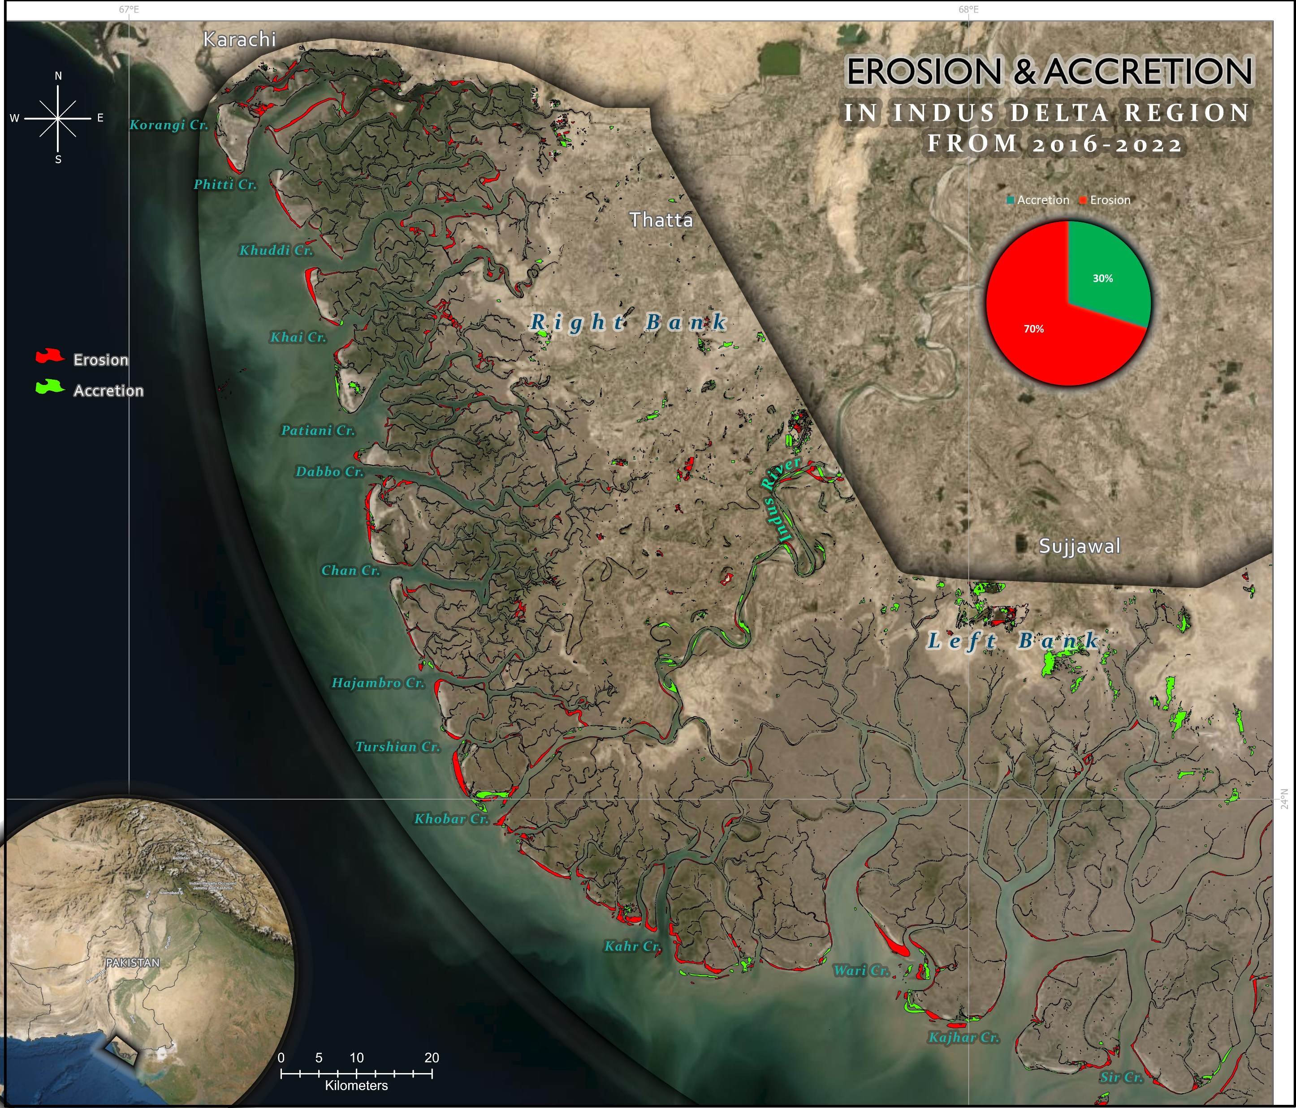
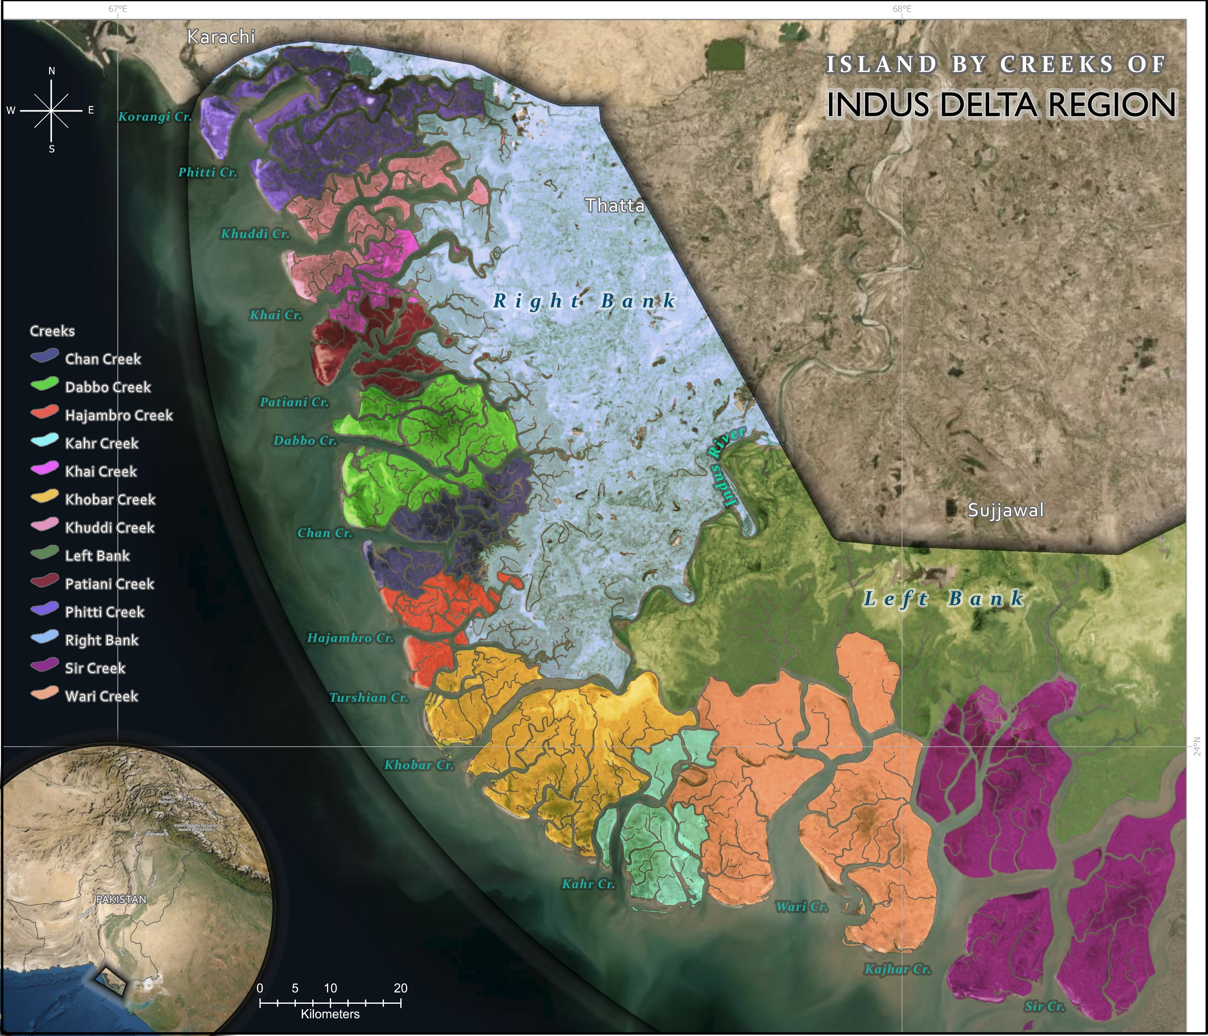
COASTAL EROSION
The analysis caried out concluded that the left side of the river Indus was more vulnerable to coastal erosion compared to the right side of the river.
It might be due to low mangrove population, oil extraction, flat land slope on the left side of the delta compared to the right side of the delta
About 42607 ha land of Indus delta is degraded. Out total degraded land about 31656 ha of land are now under the seawater while about 10951 ha of new land is converted into the tidal floodplain area

Slide 13
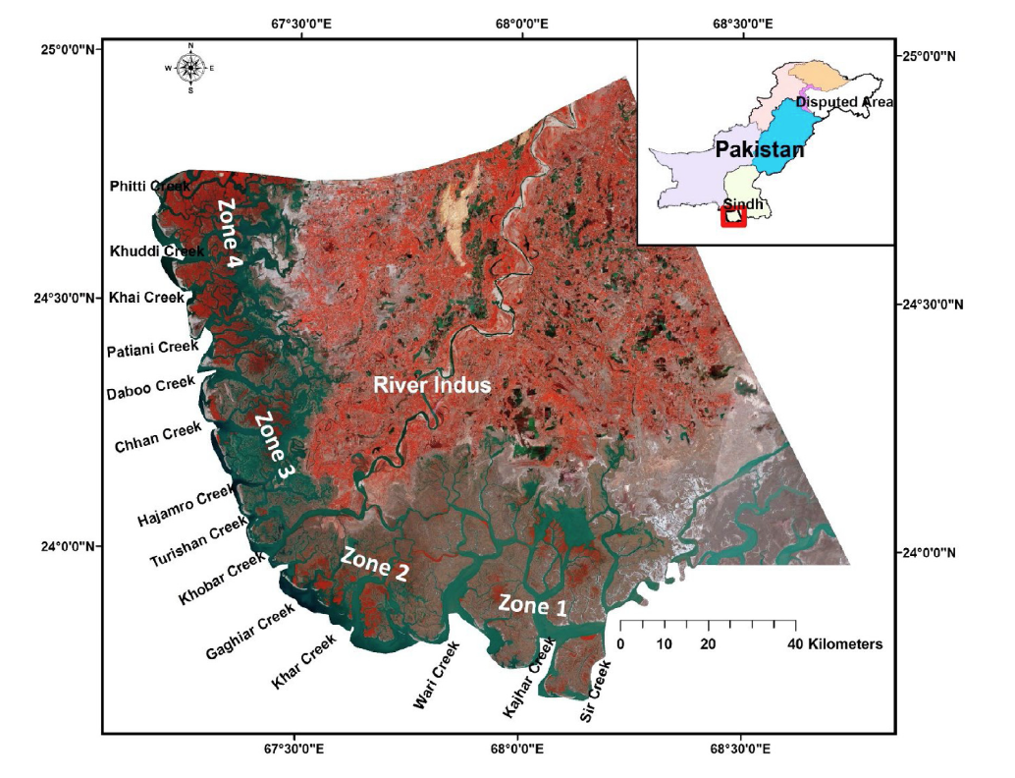
SEA WATER INTRUSION - IMPACTS
During flourishing days of Delta (1990-2005), there were seventeen river mouths (creeks) which have now decreased to only two active creeks viz. Khobar and Khar.
The active delta occupied an area of about 1.29 million hectares in 1833 which has now shrunk to only 0.1million hectares (about 92% reduction in the area)

Slide 14
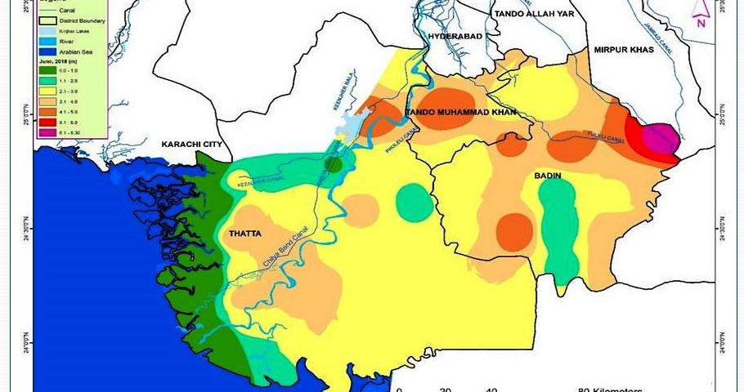
SEA WATER INTRUSION - IMPACTS
seawater intrusion has affected about 1.15 Mha (88.3%) of Indus Delta while only 0.15 Mha (11.7%) is still unaffected.

Slide 15

SEA WATER INTRUSION - IMPACTS
The World Bank projected that by 2050, Pakistan could lose up to 5% of its land area due to sea level rise, with coastal areas being particularly vulnerable.
By 2100, seawater intrusion could displace up to 1.2 million people in Pakistan.
1.2M
Population
2000
2010
2015
2020
2025
2030
2050
2100
Year

Slide 16
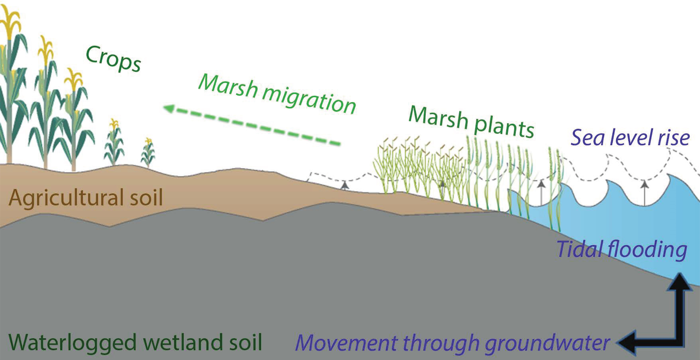

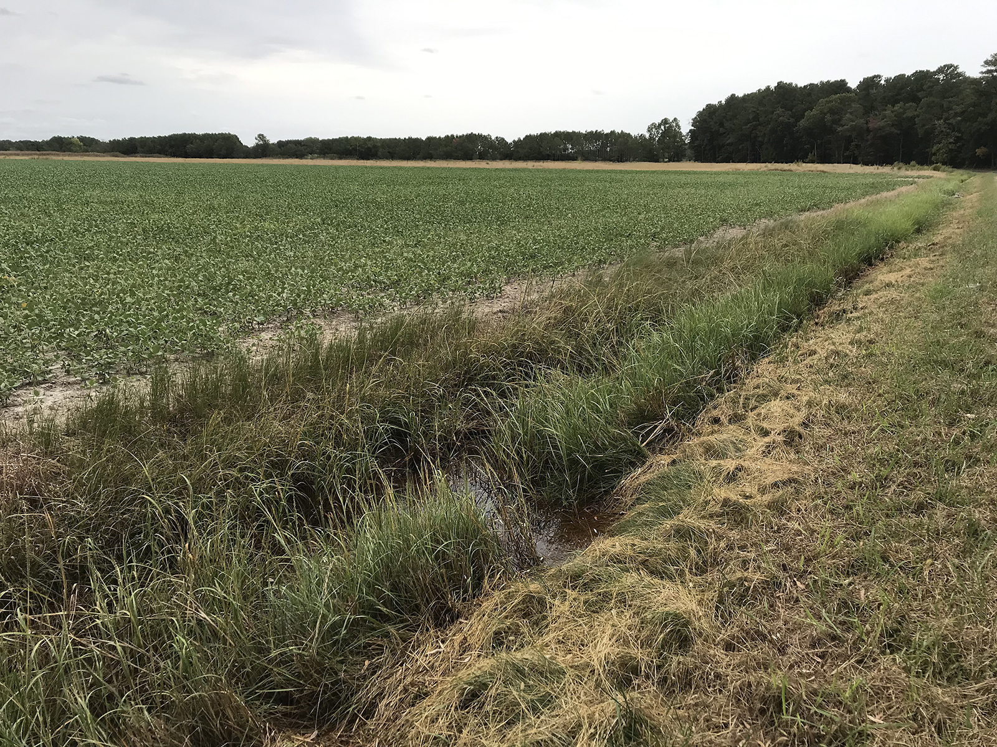
SEA WATER INTRUSION - IMPACTS
18%
It has been estimated that approximately 18% of the total cultivated land of the entire Sindh Province has been degraded due to seawater intrusion.
Total Cultivated Land
Approximately 70% of the cultivable area in Sindh is vulnerable to water-logging and salinity. It is receiving end of 80 million tons of salt annually from the upstream regions of its course.”

Slide 17
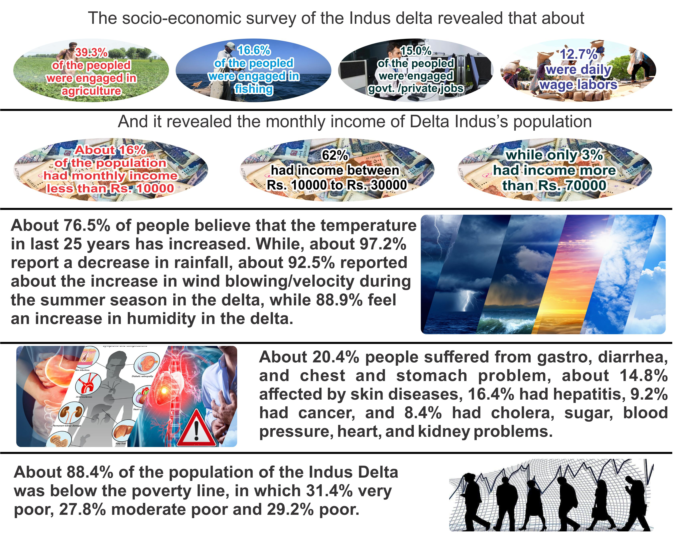
SEA WATER INTRUSION - IMPACTS

Slide 18
SEA WATER INTRUSION – PROPOSED SOLUTIONS
Environmental Restoration | Economic Development | Infrastructure | Safety and Ethical Considerations | Research and monitoring
Plant mangrove Promote bio-saline agriculture Restore natural freshwater lakes Prevent River Channel Degradation | Encourage shrimp and crab farming Support Fishery | Expand coastal highway Ensure minimum required water flow Release floodwater through revived canals | Community involvement | Research and monitoring

